Slide 1
Machine Learning
Unit – 4 – [Part 2]
Bayesian Estimation with Normal Distribution

Slide 2
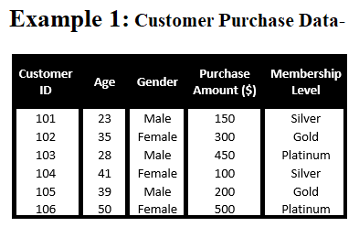
Normal Data vs Normally Distributed Data
Why is this not normally distributed?
Categorical features like gender and membership make it non-Gaussian.

Slide 3
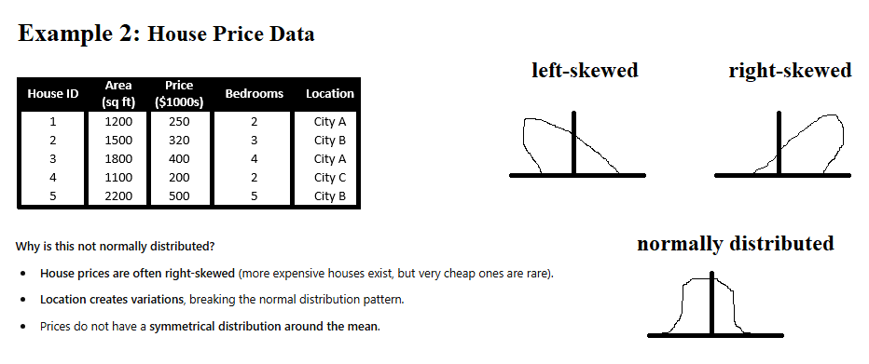

Slide 4
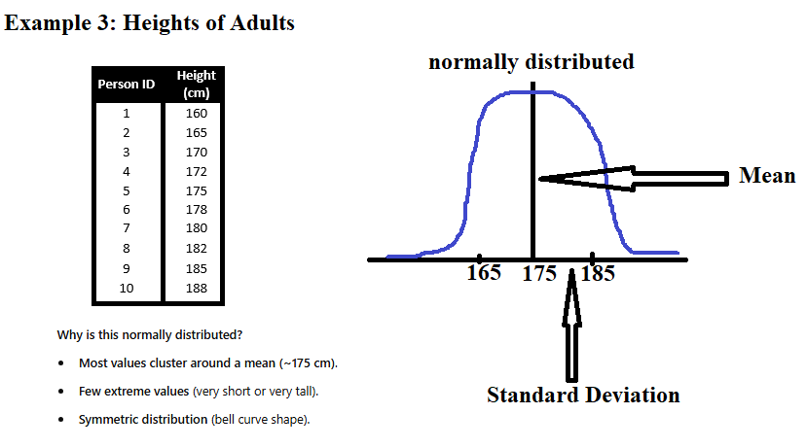

Slide 5
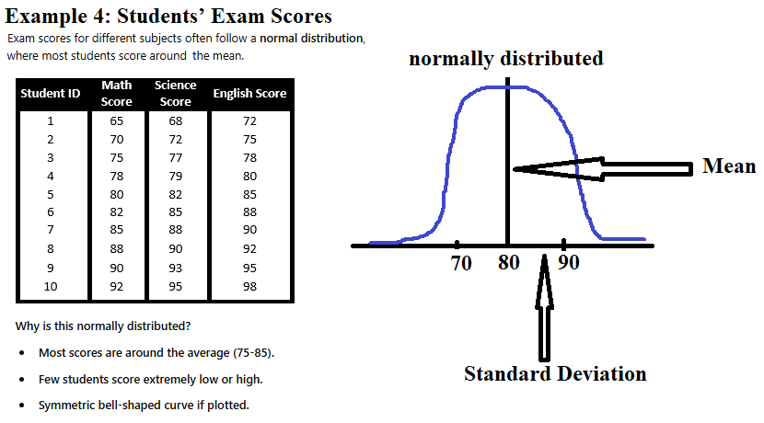

Slide 6
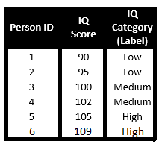
Given a dataset, implement the Naïve Bayes algorithm to classify the new data (112) based on the provided features and labels.

Slide 7
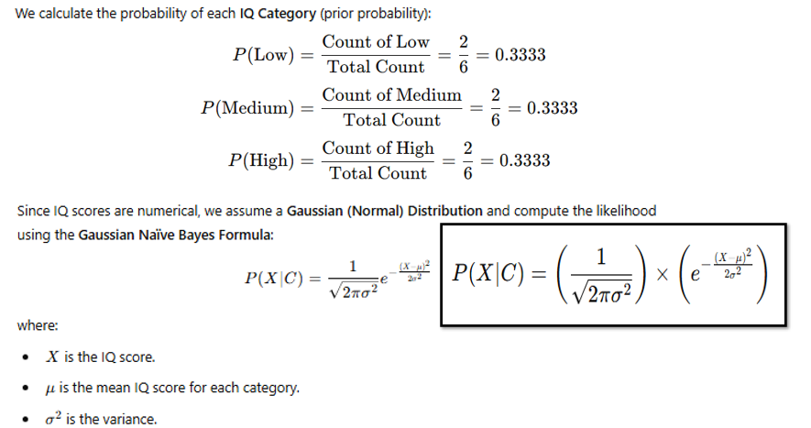

Slide 8
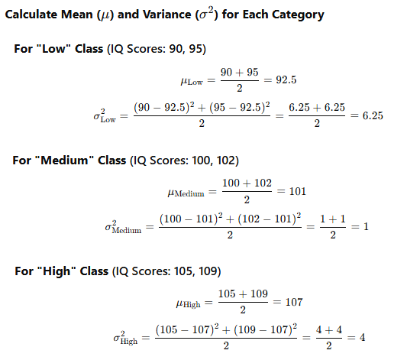

Slide 9
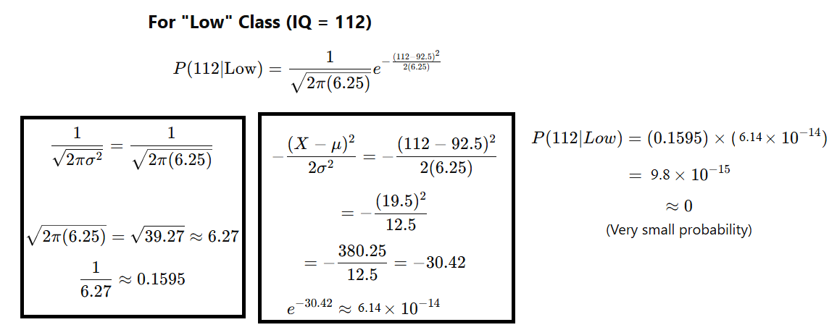

We got a new data 112, I want to use naïve bytes to find whether

Slide 10
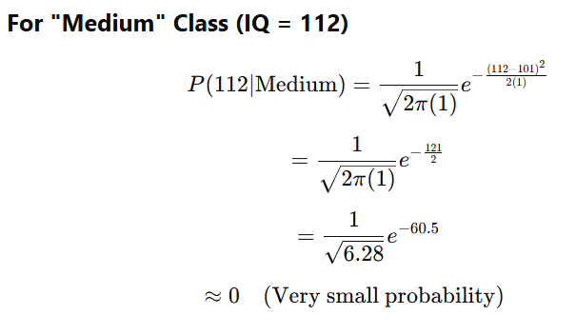

Slide 11
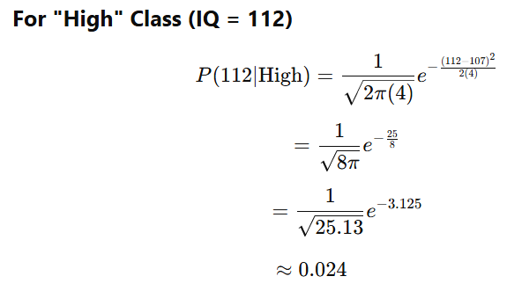

Slide 12
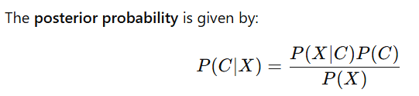
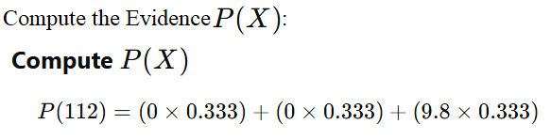


Now, we will calculate posterior probabilities:-

Slide 13
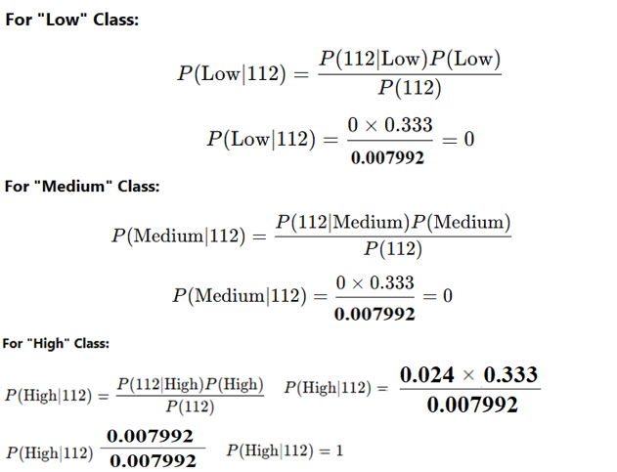

Slide 14
